Slide 1


Department of CSE
Deep Learning
20CS3269AA
Topic:
McCulloch Pitts ANN
Session - 2

Slide 2



AIM OF THE SESSION
To familiarize students with the concept of McCulloch Pitts Neuron
INSTRUCTIONAL OBJECTIVES
This Session is designed to:
Demonstrate the principle of McCulloch Pitts Neuron
Know about threshold logic
Solve Boolean Functions Using M-P Neuron
LEARNING OUTCOMES
At the end of this session, you should be able to:
Able to solve simple problems with McCulloch Pitts Neuron model

Slide 3
SESSION INTRODUCTION
McCulloch Pitts Neuron
Characteristics of McCulloch Pitts ANN.
Threshold Logic
02/07/2024
Deep learning
<number>

Slide 4
SESSION DESCRIPTION
02/07/2024
Deep learning
<number>

Slide 5
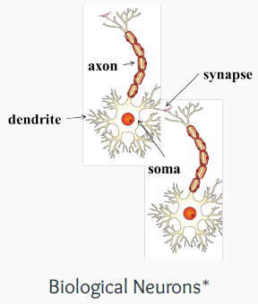
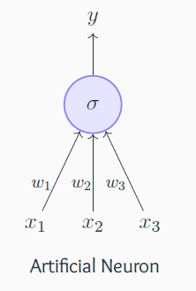
McCulloch Pitts Neuron
Biological Neurons
The most fundamental unit of a deep neural network is called an artificial neuron
• Why is it called a neuron ? Where does the inspiration come from ?
• The inspiration comes from biology (more specifically, from the brain)
biological neurons = neural cells = neural processing units
dendrite: receives signals from other neurons
synapse: point of connection to other Neurons
soma: processes the information
axon: transmits the output of this neuron
02/07/2024
Deep learning
<number>

Slide 6
Biological Inspiration
Animals are able to react adaptively to changes in their external and internal environment, and they use their nervous system to perform these behaviours.
An appropriate model/simulation of the nervous system should be able to produce similar responses and behaviours in artificial systems.
The nervous system is build by relatively simple units, the neurons, so copying their behavior and functionality should be the solution.
The spikes travelling along the axon of the pre-synaptic neuron trigger the release of neurotransmitter substances at the synapse.
The neurotransmitters cause excitation or inhibition in the dendrite of the post-synaptic neuron.
The integration of the excitatory and inhibitory signals may produce spikes in the post-synaptic neuron.
The contribution of the signals depends on the strength of the synaptic connection.
02/07/2024
Deep learning
<number>

Slide 7
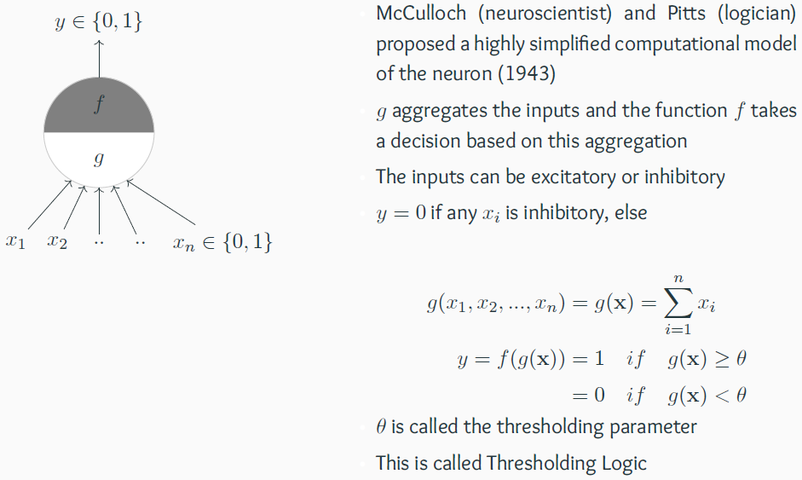
McCulloch Pitts Neuron:: Threshold Logic
02/07/2024
Deep learning
<number>

Slide 8
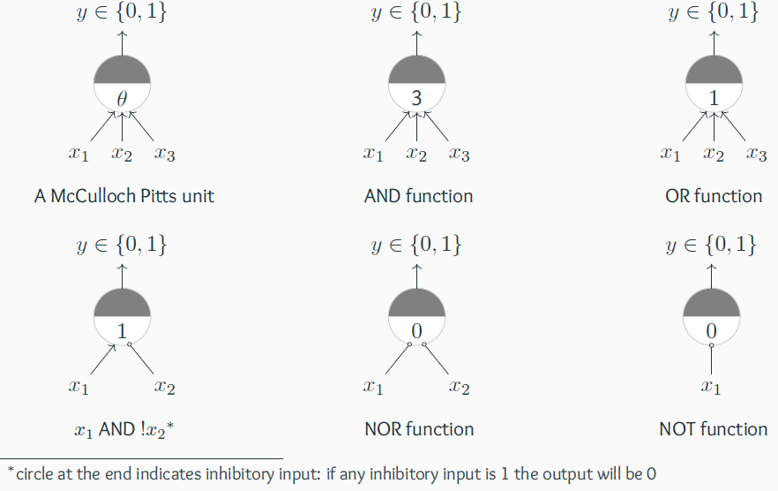
Boolean Functions
02/07/2024
Deep learning
<number>

Slide 9
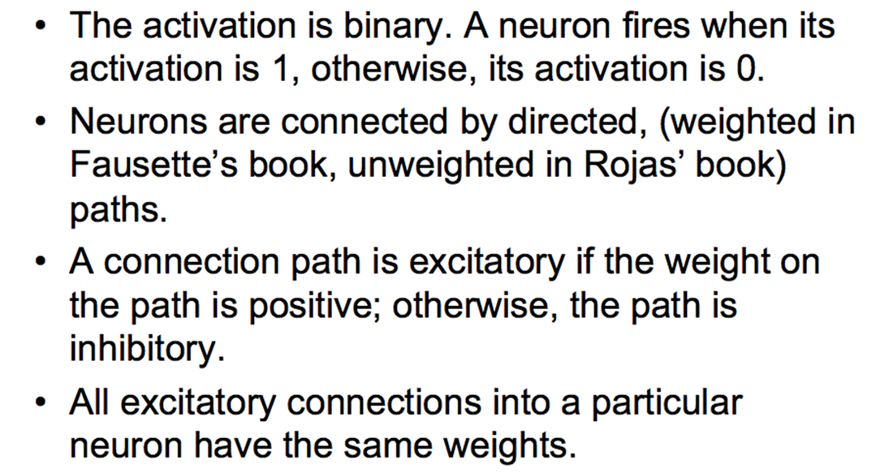
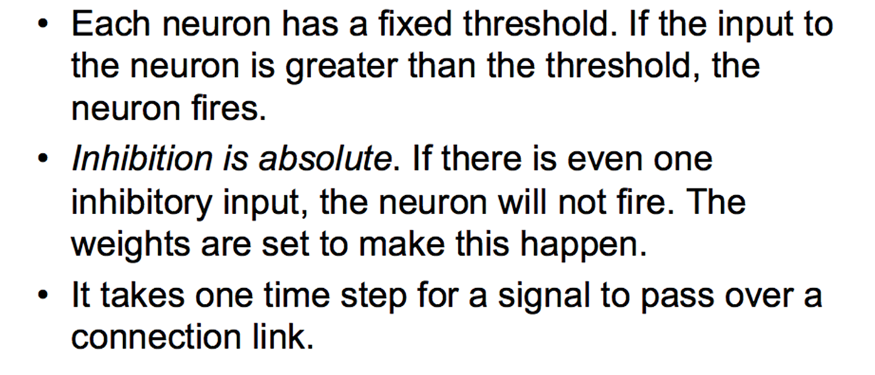
Characteristics of McCulloch Pitts ANN
02/07/2024
Deep learning
<number>

Slide 10
Limitation of MP model
Boolean input
Boolean outputs
Linear data
Fixed slope
Few possible intercepts
02/07/2024
Deep learning
<number>

Slide 11
SELF-ASSESSMENT QUESTIONS
McCulloch Pitt model was invented in -------- year.
…____________ and ______ invented McCulloch Pitt model
3. inhibitory inputs are the inputs which are __________________

Slide 12
TERMINAL QUESTIONS
List out the Characteristics of McCulloch Pitts ANN.
What is Threshold Logic for McCulloch Pitts Neuron
Implement logic gates using McCulloch Pitts Neuron
What types of functions is a network of McCulloch-Pitts neurons capable of computing?
Build MP-model for selecting the book to read from the given book information
Derive expressions for the weights and thresholds of a McCulloch-Pitts neuron that can compute the following input-output mappings:
i1 i2 out
0 0 1
0 1 0
1 0 0
1 1 0
What is the thresholds to implement above network
02/07/2024
Deep learning
<number>

Slide 13
REFERENCES FOR FURTHER LEARNING OF THE SESSION
Books:
1 Ian Goodfellow and Yoshua Bengio and Aaron Courville (2016) Deep Learning Book
Sites and Web links:
1.https://www.youtube.com/watch?v=X4RmokyD3U8&list=PLyqSpQzTE6M9gCgajvQbc68Hk_JKGBAYT&index=19
2. https://towardsdatascience.com/mcculloch-pitts-model-5fdf65ac5dd1
3. https://medium.datadriveninvestor.com/mp-neuron-and-perceptron-98abbd542e47
02/07/2024
Deep learning
<number>

